Slide 1
Preconception care
Assist lecturer: Alyaa Hussein

Slide 2
Preconception care is the provision of biomedical, behavioural and social health interventions to women and couples before conception occurs, aimed at improving their health status, and reducing behaviours and individual and environmental factors that could contribute to poor maternal and child health outcomes. Its ultimate aim is improved maternal and child health outcomes, in both the short and long term

Slide 3
At least three overlapping terms are used in the reviews tabled at the meeting:
Preconception care – provision of preventive, promotive or curative health and social interventions before conception occurs;
Periconception care – provision of these interventions in the period extending from 3 months before to 3 months after conception occurs;
Interconception care – provision of these interventions between two pregnancies

Slide 4
4 out of 10 women report that their pregnancies are unplanned
Perinatal deaths are 50% higher among babies born to adolescent mothers
Up to 10% of pregnancies among women with untreated gonococcal infections result in perinatal death

Slide 5
Preconception care can make a useful contribution to reducing maternal and childhood mortality and morbidity, and to improving maternal and child health in both high- and low-income countries.
In high-income countries, in addition to optimizing general preconception health and risk awareness of the population as a whole, preconception care can address the relatively higher levels of maternal and childhood mortality and morbidity that exist in some pockets of socially marginalized and economically deprived families and communities. In low-income countries, similar but larger effects may be achieved.

Slide 6
Potential benefits of preconception care
From the perspective of health outcomes, in the short term preconception care could reduce pregnancies that are too early, pregnancies that are too close, and unplanned pregnancies.
Preconception care could contribute to reducing the risk of genetic disorders and environmental exposure, to reducing maternal and childhood mortality, and to improving maternal and child health outcomes.

Slide 7
It could also contribute to improving the health and well-being of women in other areas of public health, such as nutrition, infertility and subfertility, mental health, intimate partner and sexual violence, and substance use. In the long term, preconception care could contribute to improving the health of babies and children as they grow into adolescence and adulthood.

Slide 8
By supporting women to make well-informed and well-considered decisions about their fertility and their health, preconception care could contribute to the social and economic development of families and communities. By creating awareness of the importance of men’s health and men’s behaviours on maternal and child health outcomes, and by promoting male involvement, preconception care could result in additional benefits.
From the programmatic perspective, preconception care provides a window to include interventions that have not traditionally been included in maternal,newborn and child health programmes, such as reduction in use of and exposure to tobacco.

Slide 9
Preconception care interventions
Nutritional deficiencies and disorders
Vaccine-preventable infections
Tobacco use
Environmental risks
Genetic disorders
Early pregnancies, unwanted pregnancies, and pregnancies in rapid succession
Sexually transmitted infections (STIs), including human immunodeficiency Virus (HIV)

Slide 10
infertility and subfertility
female genital mutilation
mental health disorders, including epilepsy
psychoactive substance use
intimate partner and sexual violence.
These interventions would need to be delivered using a mix of methods:
health education and promotion
vaccination
nutritional supplementation and food fortification
provision of contraceptive information and services
screening, counseling and management (medical and social).

Slide 11
Screening for anemia
Supplementing iron and folic acid
Information, education and counselling
Monitoring nutritional status
Screening for diabetes mellitus
Management of diabetes mellitus
Counselling people with diabetes mellitus
Monitoring blood glucose (also in pregnancy)
Promoting exercise
Salt iodization

Slide 12
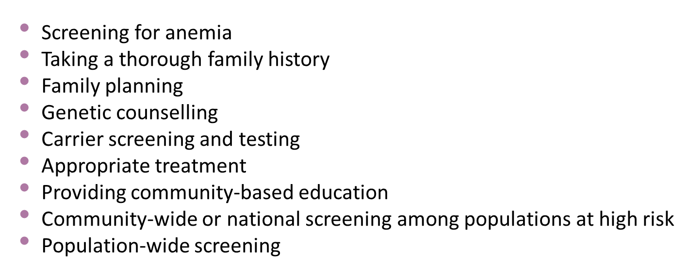
Genetic conditions

Slide 13
Too-early, unwanted and rapid successive pregnancy
Keeping girls in school
Influencing cultural norms that support early marriage and coerced sex
Educating girls and boys about sexuality, reproductive health and contraceptive use
Building community support for preventing early pregnancy and for contraceptive provision to adolescents
Enabling adolescents to obtain contraceptive services
Empowering girls to resist coerced sex
Educating women and couples about the dangers to the baby and mother of short birth intervals
Providing contraceptives

Slide 14
Thanks

